Slide 1

UNDERSTANDING THE WEB

Slide 2
Agenda
Understanding HTTP Basics
What is a WebPage?
Types of Web page
What is Website?
What is a WebApplication?
Difference between Website and WebApplication
What is internet?
Generations of Wireless Network
Internet Based Services
History and Evolution of the Internet
Pros and Cons of Using the Internet
WWW
URL
DNS
Notes:
Agenda of this module is as given below:
What is internet?
Internet Based Services
World Wide Web (WWW)
Generations of Wireless Network
History and Evolution of the Internet
Pros and Cons of Using the Internet
Understanding HTTP Basics
What is a WebPage?
Types of Web page
What is Website?
What is a WebApplication?
Difference between Website and WebApplication

Slide 3

What is Internet?
Internet is a world-wide global system of interconnected computer networks.
Internet uses the standard Internet Protocol (TCP/IP).
Notes:
Let’s understand what is actually internet.
The web is a part of the internet, even though people often use the two terms interchangeably. It was invented in 1989 by Tim Berners-Lee, who was a computer scientist at the European Organization for Nuclear Research. What Tim Berners Lee invented sounds awfully similar to the internet: a way to share things over a network.
The internet and the web sound similar to each other because the web is built on top of the internet.
The internet is a group of computers, whereas the web is a group of machines and their documents. When you download a file through the web, you are accessing an external file (a file that is not located on your device) and creating a local copy on your device.
Reference - https://openclassrooms.com/en/courses/3314571-understanding-the-web/4511386-what-is-the-web

Slide 4
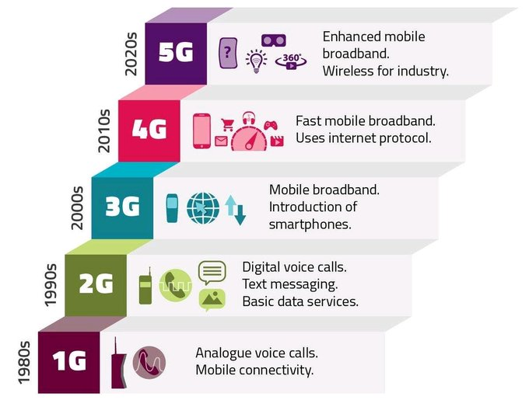
Generations of Wireless Network
https://galooli.com/glossary/what-is-a-network-generation/
Notes:
A wireless network is a computer network that uses wireless data connections between network nodes.
Wireless networking is a method by which homes, telecommunications networks and business installations avoid the costly process of introducing cables into a building, or as a connection between various equipment locations.
As you can see in this image, there 4 different generations came till now. For more description refer image.
Reference - https://en.wikipedia.org/wiki/Wireless_network

Slide 5
Internet Based Services
Electronic mail
World wide web
File transfer protocol
Chat rooms
Mailing list
Instant messaging
News groups
Notes:
To access/exchange a large amount of data such as software, audio clips, video clips, text files, other documents, etc., we need internet services. You must use an Internet service to connect to the Internet. Data can be sent from Internet servers to your machine via Internet service. Some of the commonly used internet services are :
Electronic mail
World wide web
File transfer protocol
Chat rooms
Mailing list
Instant messaging
News groups
References - https://www.geeksforgeeks.org/internet-and-its-services

Slide 6
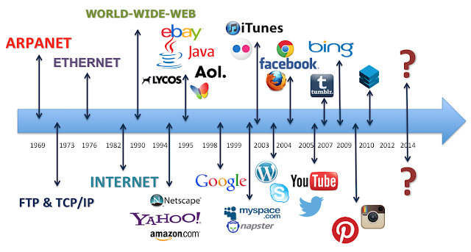
History and Evolution of the Internet
https://ahmadfaizar.blogspot.com/p/evolution-of-web-web-10-web-20-web-30.html

Slide 7
Pros and Cons of Using the Internet
Advantages
Sharing Information
Communication
Entertainment
Advertisement
News
Customer support and service
Feedback from users
Collection of information
Disadvantages
Viruses
Theft of personal information
Immorality
Wastage of times
Spamming
Language problems

Slide 8

World Wide Web (WWW)
The World Wide Web (WWW), commonly known as the Web, is an information system enabling documents and other web resources to be accessed over the Internet.
https://disenowebakus.net/en/world-wide-web
Notes:
The World Wide Web (WWW), commonly known as the Web, is an information system enabling documents and other web resources to be accessed over the Internet.
Documents and downloadable media are made available to the network through web servers and can be accessed by programs such as web browsers. Servers and resources on the World Wide Web are identified and located through character strings called uniform resource locators (URLs). The original and still very common document type is a web page formatted in Hypertext Markup Language (HTML).
Reference - https://en.wikipedia.org/wiki/World_Wide_Web

Slide 9
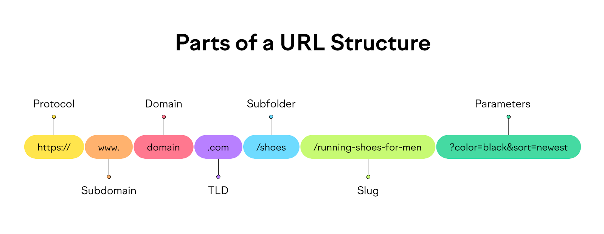
URL (Uniform Resource Locator)
URL is the address of a resource on web.
Example: https://www.edunetfoundation.org
Here, HTTP is Protocol
WWW is World Wide Web
edunetfoundation is resource name
org is domain name
https://www.semrush.com/blog/what-is-a-url/

Slide 10
DNS (Domain Name System)
DNS is kind of directory service.
It provides mapping between host name and its numerical address
Numerical Address is nothing else but the IP address of any resource which is stored on server
Example of IP address : 172.16.16.21
Why DNS is required
Difficult to remember numerical address of different resources

Slide 11
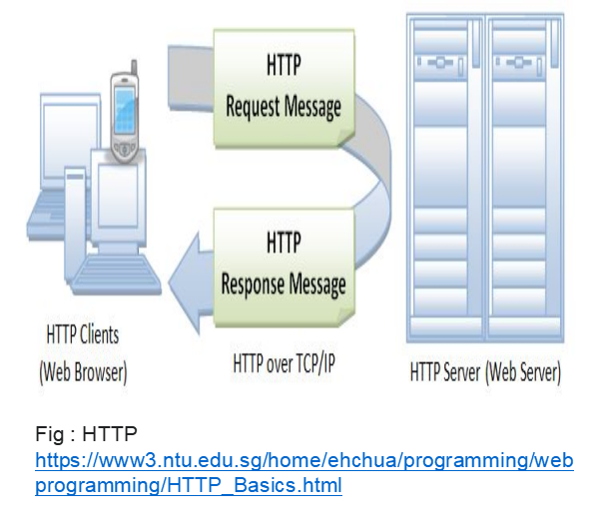
Understanding HTTP Basics
Stands for "Hypertext Transfer Protocol."
HTTP is based on a request and a response.
HTTP is the protocol used to transfer data over the web.
HTTP is the protocol that is used by web servers and browsers to communicate.
Notes:
Stands for "Hypertext Transfer Protocol."
HTTP is based on a request and a response.
HTTP is the protocol used to transfer data over the web.
HTTP is the protocol that is used by web servers and browsers to communicate.

Slide 12
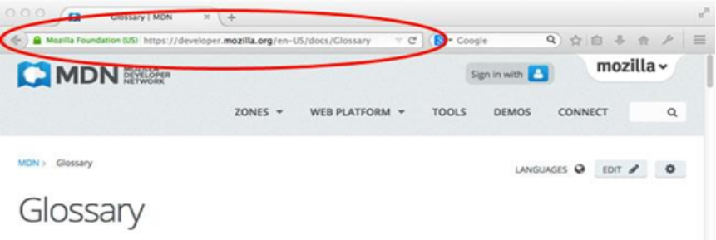
What is a WebPage?
A web page can contain huge information including text, graphics, audio, video , and hyperlinks.
These hyperlinks are the link to other web pages.
https://developer.mozilla.org/enUS/docs/Learn/Commonquestion/Pagessitesserversandsearchengines
Notes:
What is a WebPage?
A web page can contain huge information including text, graphics,audio,video
and hyperlinks.
These hyperlinks are the link to other web pages.

Slide 13
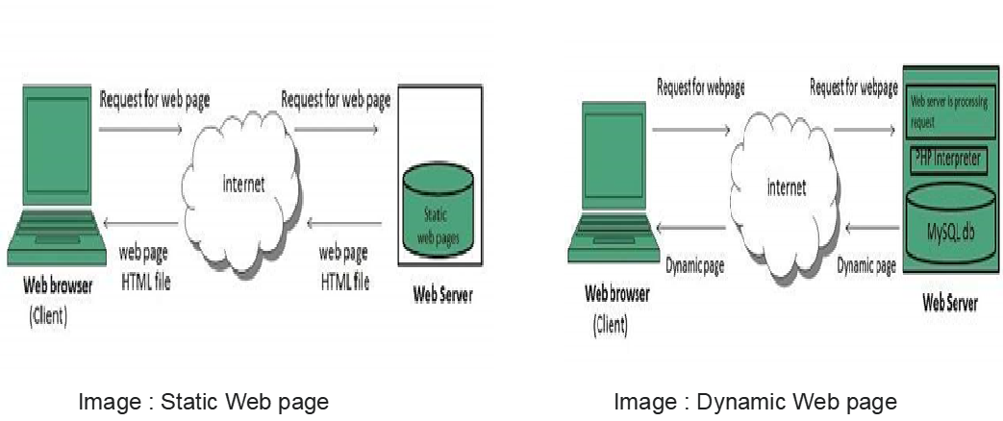
Type of Web Pages
https://www.tutorialspoint.com/internet_technologies/web_pages.htm
Notes:
Type of Web Pages
Web page is a document available on world wide web. Web Pages are stored on web server and can be viewed using a web browser. A web page can cotain huge information including text, graphics, audio, video and hyper links. These hyper links are the link to other web pages.
Static web pages are also known as flat or stationary web page. They are loaded on the client’s browser as exactly they are stored on the web server. Such web pages contain only static information. User can only read the information but can’t do any modification or interact with the information.
Static web pages are created using only HTML. Static web pages are only used when the information is no more required to be modified.
Dynamic web page shows different information at different point of time. It is possible to change a portaion of a web page without loading the entire web page.
Reference - https://www.tutorialspoint.com/internet_technologies/web_pages.htm

Slide 14
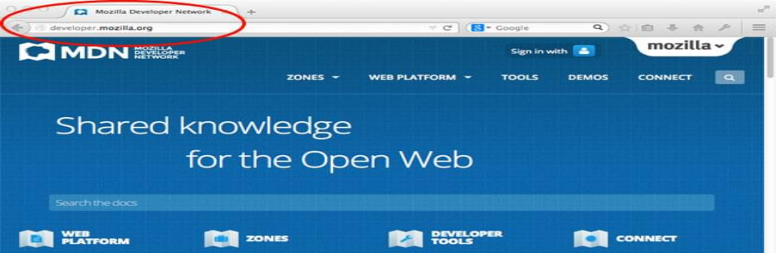
What is a Website?
A website is a collection of linked web pages that shares a unique domain name.
https://developer.mozilla.org/enUS/docs/Learn/Commonquestion/Pagessitesserversandsearchengines

Slide 15
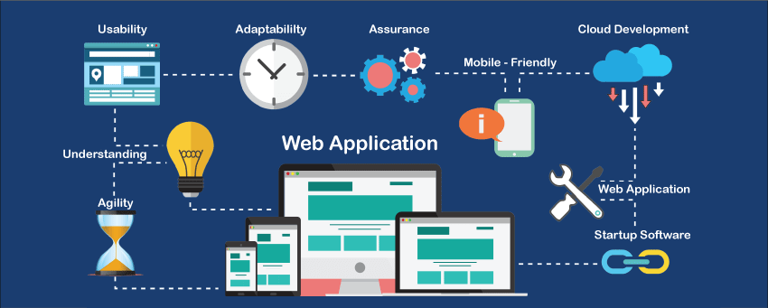
What is a Web Application?
Web application is a client-side and server-side software application in which the client runs or request in a web browser.
https://www.javatpoint.com/web-application

Slide 16
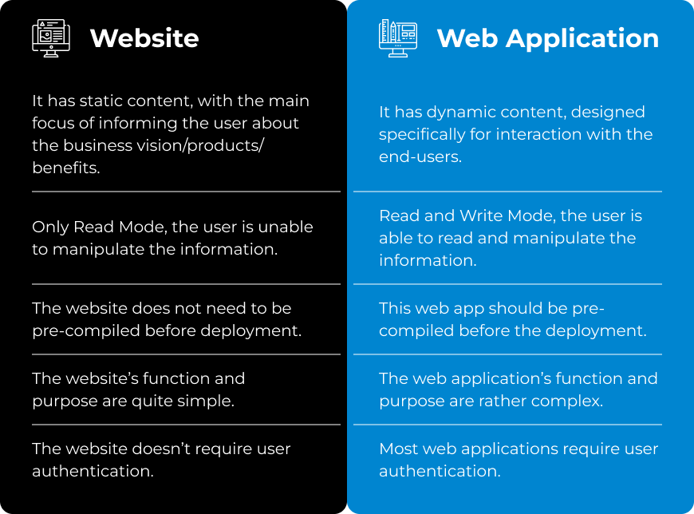
Difference Between Web application and Website
https://wesrom.com/insights/engineering-insights/website-vs-web-application-what-should-you-choose-wesrom/

Slide 17
HTML

Slide 18
Agenda
HTML
HTML Page Structure
HTML Formatting Tags
Heading Tags
Hyper Link
Image
List
Table
Form
Graphics
Multimedia
Block components
Notes:
Agenda of this module is as given below:
HTML
HTML Page Structure
List
Tables
Graphics
Multimedia
Forms
Text Formatting
Block components

Slide 19
HTML
HTML stands for Hyper Text Markup Language
HTML elements are the building blocks of HTML pages
HTML describes the structure of Web pages using Hypertext markup language
HTML elements are represented by tags
When you test your page on browsers. Browsers do not display the HTML tags but use them to render the content of the page.
HTML page extension always will be .html (example.html)
Notes:
HTML
HTML stands for Hyper Text Markup Language
HTML elements are the building blocks of HTML pages
HTML describes the structure of Web pages using Hypertext markup language
HTML elements are represented by tags
When you test your page on browsers. Browsers do not display the HTML tags but use them to render the content of the page.
HTML page extension always will be .html (example.html)

Slide 20
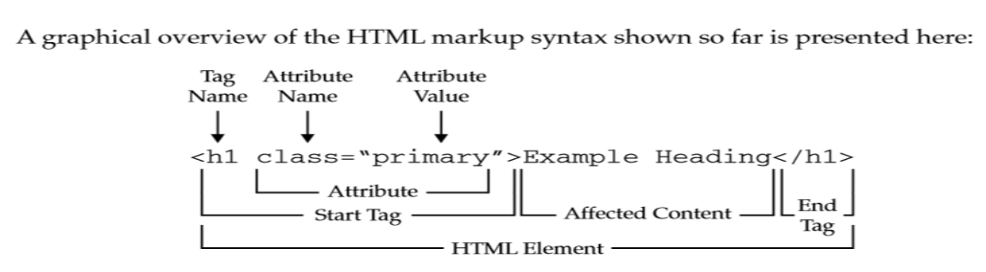
Tags and Elements
Tags are used to add content in html, like text, headings, table, list links etc. Tags along with attributes are core components of HTML. The latest version of HTML, i.e HTML5 includes 145 tags.
An HTML Tag with attributes and content is called HTML Element. Element include start tag, end tag, attributes and content inside.
All HTML Elements are built using HTML tags.

Slide 21
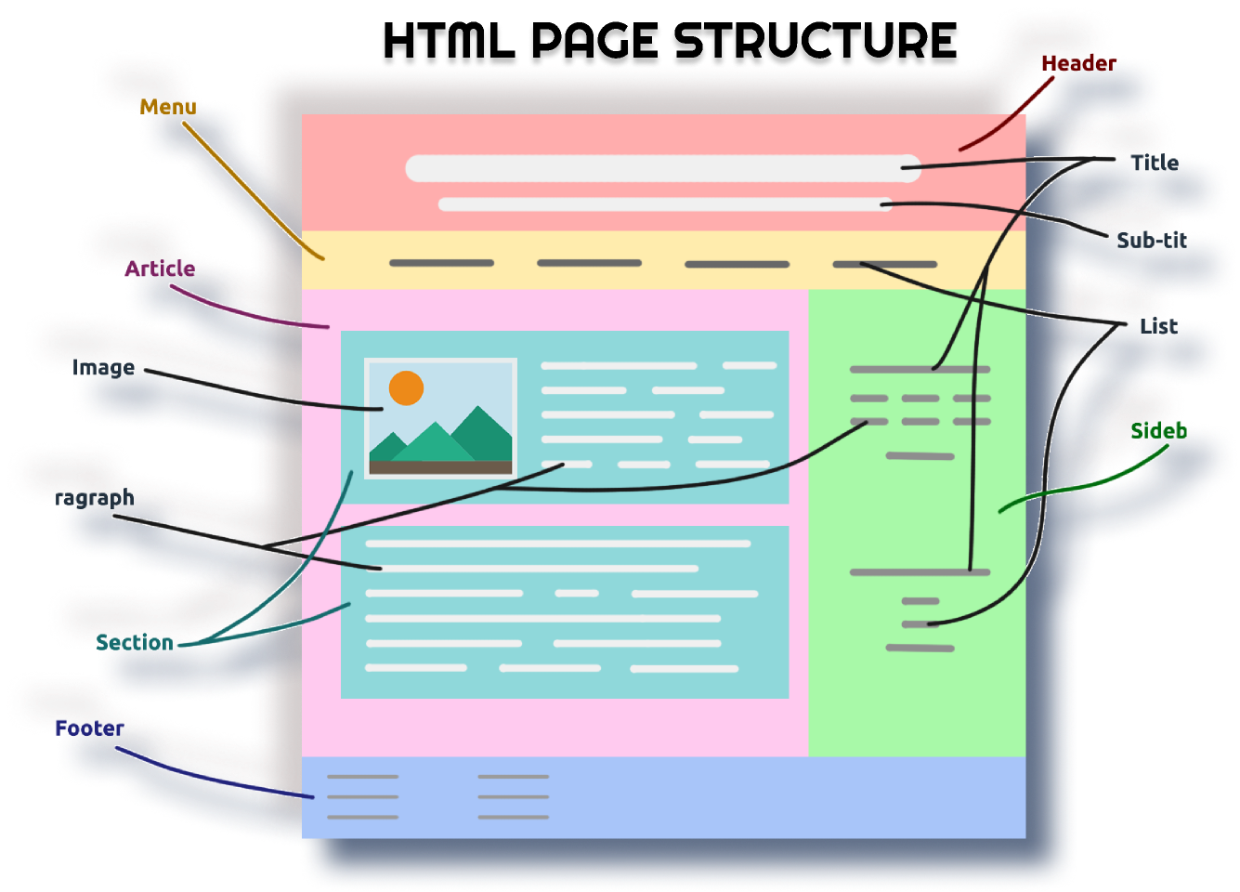
https://www.figma.com/community/file/1053304969390475630/Basic-Structure-of-a-HTML-Page

Slide 22
Type of HTML Tags
Paired Tags
Paired Tags are tags with both opening and closing. They can have child tags, plain text and attributes.
Unpaired Tags
Unpaired tags are tags with an opening only, for example <img>, <input> etc. They can have attributes.

Slide 23
HTML Tag <html>
HTML Tag is the parent tag of all HTML Elements. It is also called a root tag.
HTML Tag has two children, head tag and body tag. Since HTML3, It is compulsory to define doctype and then HTML tag.
lang attribute is used inside html tag to define language. An option dir="ltr" is also used to add direction which is by default left to right.

Slide 24
Head and body tag
HTML Head tag is the first child of HTML. Head includes all the information related to webpage seo, css links, scripts and meta tags.
Head is not visible to user. It is mainly for search engines and browsers.
HTML Body Tag is used to define the body of our HTML Document, basically the content visible to the user.
The Body Tag contain all visible contents of a web page like paragraph, headings, tables, lists, images, videos visible to user.
By default, the body is 100% wide, has a white background, and took a margin of 8px.
Notes:
An HTML Document is mainly divided into two parts:
HEAD: This contains the information about the HTML document. For Example, the Title of the page, version of HTML, Meta Data, etc.
BODY: This contains everything you want to display on the Web Page.
<!DOCTYPE html>: This tag is used to tells the HTML version. This currently tells that the version is HTML 5.0
<html> </html> : <html> is a root element of html. It’s a biggest and main element in complete html language, all the tags , elements and attributes enclosed in it or we can say wrap init , which is used to structure a web page. <html> tag is parent tag of <head> and <body> tag , other tags enclosed within <head > and <body>. In <html > tag we use “lang” attributes to define languages of html page such as <html lang=”en”> here en represents English language. some of them are : es = Spanish , zh-Hans = Chinese, fr= french and el= Greek etc.
<head>: Head tag contains metadata, title, page CSS etc. Data stored in the <head> tag is not displayed to the user, it is just written for reference purposes and as a watermark of the owner.
<body>: A body tag is used to enclose all the data which a web page has from texts to links. All the content that you see rendered in the browser is contained within this element.
Reference - https://www.geeksforgeeks.org/html-course-structure-of-an-html-document

Slide 25
Title and meta tag
Title Tag is the compulsory child of HEAD. The title is compulsory and should be unique on all web pages. Title enhances search engine visibility of a webpage on various search engines. The maximum limit of characters inside the title tag is 70 for maximum search engines.
Always use the first targeted keyword in the title for best SEO results.
Meta charset was introduced in HTML5. Earlier meta tag with content and http-equiv was used to declare charset.
Meta charset is used to declare webpage character encoding. The recommended charset for maximum websites is UTF-8. The default charset for Windows OS is windows-1252.

Slide 26
HTML Heading Tag
HTML headings can be defined with <h1> to <h6>
<h1> - most important heading
<h6> - least important heading
Search engines use the headings to index the structure and content of your web pages.
Example:
<h1> Most Important Heading </h1>
<h2> Second Important Heading </h2>

Slide 27
HTML Formatting Tag
<b> - Apply Bold effect on content
<i> - Apply italic effect on content
<u> - Apply underline to the content
<strong> - Add on the importance to the content
<em> - Apply emphasized effect on content
<ins> - Insert content to web page
<del> - Use to delete the content
<mark> - highlight the content
<sub> - Subscript text : ex – X2
<sup> - Superscript text : ex – X2
<small> - write content in smaller font size than normal font size
<big> - Write content in bigger font size than normal font size

Slide 28
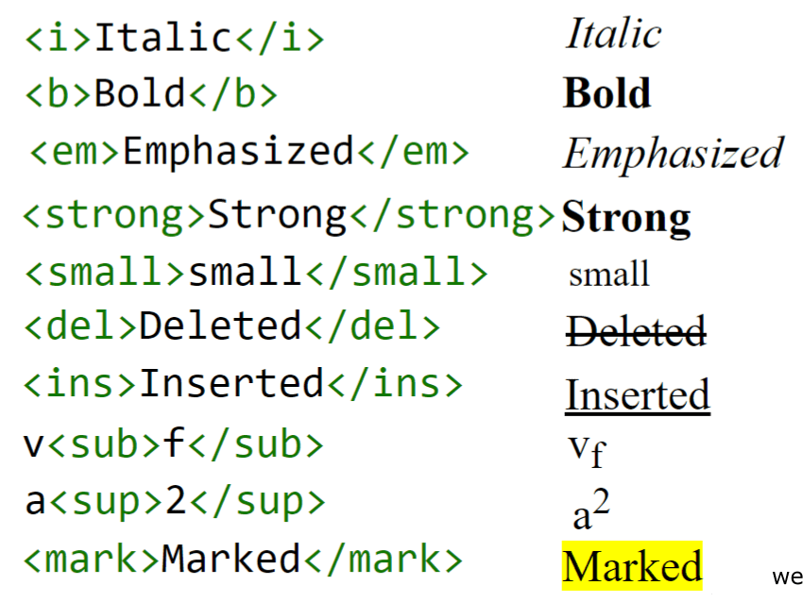
Example :
Image : Text-Formatting
https://www.web4college.com/html/socialImages/html-text-formatting.png
Notes:
Again, a few text formatting elements have been shown along with description.

Slide 29
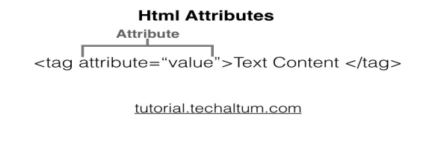
HTML Attributes
HTML elements can have attributes in opening or start tag.
Attribute provides additional information about that element.
HTML attributes are added in the opening tag and can have some value. Some popular Global Attributes are class, id, title, style etc.
Notes:
HTML Attributes
HTML elements can have attributes in the opening or start tag.
Attribute provides additional information about that element.
HTML attributes are added in the opening tag and can have some value. Some popular Global Attributes are class, id, title, style etc.

Slide 30
Attributes Type
Attribute Type | Meaning
Global Attribute | Attributes meant for all html elements. Exp : class, id
Boolean Attribute | Attribute with Attribute name only, no value.Exp :disabled, hidden, reversed etc.
Presentational Attributes | Attributes used to style HTML Elements. For example : style, size, color, border, cellspacing, cellpadding etc.
Event Attributes | Event attributes are used to add javascript event on html element, like onclick, onmouseover, onmouseout, etc.

Slide 31
HTML Attributes
Attribute | Element | Description
class | Global Attribute | used to group elements for css
id | Global Attribute | Assign a unique id for the element
name | Global Attribute | Assign name of an element
style | Global Attribute | CSS attribute for tags (Specifies an inline style for an element)
title | Global Attribute | Specifies extra information about an element (displayed as a tooltip)
type | <input>, <audio>, <video>,<embed>, <iframe>, <source>, <script>,<track>, <ol> | Defines type of element.

Slide 32
HTML ATTRIBUTES
Attribute | Element | Description
src | <img>, <script>, <input>,<audio>, <video>, <embed>,<iframe>, <source>, <track> | source of media element
href | <a>, <link>, <base> | hypertext reference, path of hyperlink ( <a>) and link tag
width | <img>, <embed>, <video>, <iframe> | Set width of element
height | <img>, <embed>, <video>, <iframe> | Set height of element
value | <input>, <option> | Set default value of element visible at pageload
size | <input>, <select> | Width of element in px. For input type text, size means no of characters

Slide 33
HTML Block and Inline Elements
HTML Elements are classified as Block Level and Inline Level elements on the basics of their display.
Some elements display as blocks and some inline.
Block Vs Inline
<p> <div> <h1> < h2> <address> etc are block level elements,
<b>, <strong>, <i>, <span>, <u> and <s> are inline level elements.

Slide 34
DIV and span tag
Div tag
Html div tag is used to create divisions. Div is block level, thus starting from the new line and occupying the full width of the parent. Div all block level elements.
Span tag
Html span tag is used to create division inside line. Span is inline level, thus starts in the same line and occupy width of content. Span is used to group inline level elements.

Slide 35
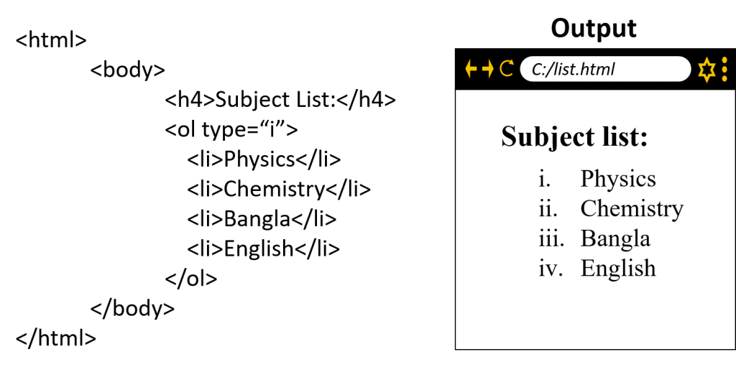
Lists
HTML Lists includes three type of lists to show single or multiple list item. These three lists are Unordered List, Ordered List and Description List, formerly known as Definition List.
There are three types of list in HTML, i.e, unordered lists , ordered lists & description list.
The ul tag is used to define unordered list and the ol tag is used to define ordered list. Inside the list, the li tag is used to define each list item.
Image : Ordered List
https://www.edupointbd.com/order-list-unorder-list-description-list/
Notes:
Lists
HTML Lists includes three type of lists to show single or multiple list item. These three lists are Unordered List, Ordered List and Description List, formerly known as Definition List.
There are three types of list in HTML, i.e, unordered lists , ordered lists & description list.
The ul tag is used to define unordered list and the ol tag is used to define ordered list. Inside the list, the li tag is used to define each list item.

Slide 36
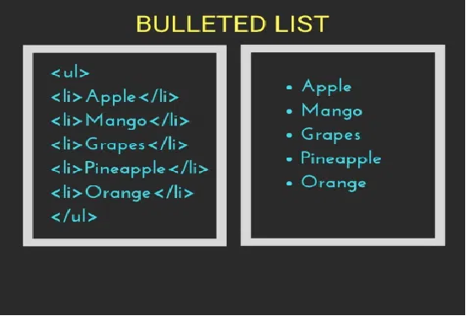
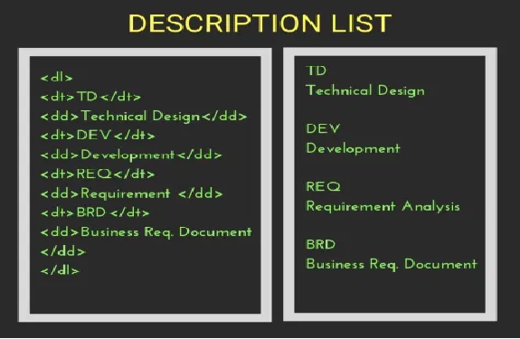
lists
Image: Unordered List & Description List
https://www.tutorialbrain.com/html_tutorial/html_lists/

Slide 37
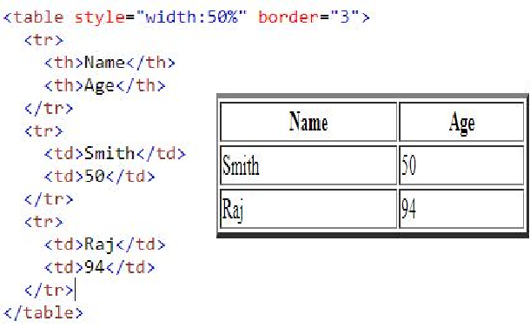
Tables
HTML tables are used for displaying data that make sense in spreadsheet software.
<table> – This tag is used to define Tables.
<tr> – table row.
<td> –table data cells.
<th> – For table heading which is bold and center.
Image: Tables
https://www.w3schools.com/html/html_tables.asp
Notes:
HTML Tables
HTML tables are used for displaying data that make sense in spreadsheet software.
<table> – This tag is used to define Tables.
<tr> – table row.
<td> –table data cells.
<th> – For table heading which is bold and center.

Slide 38
Table Attributes
Border – used to add border to the table
Cellspacing – used to add space between cells
Cellpadding – used to add space between cell border and content
Align – used to give alignment to table
Td Attributes
Colspan – used to combine 2 or more colums
Rowspan – used to combine 2 or more rows

Slide 39
HTML5
The term HTML5 means not only HTML, but it is also a combination of HTML, CSS and Javascript with APIs.
For example, drawing and animation using canvas, offline storage, microdata, audio and video, drag and drop, geolocation, embedded fonts, web APIs etc.
HTML5 includes new semantic tags and some old tags( with redefinition ).
Html5 is the combination of three web technologies:
HTML → to build webpage structure,
CSS → to enhance look and feel( presentation layer), and
Javascript → to add functionality to HTML elements.

Slide 40
HTML5 New Tags List
Picture
Footer
Header
Mark
Meter
Nav
Progress
Article
Section
Aside
Details
Summary
Time
BDI
Command
Figure
Figcaption

Slide 41
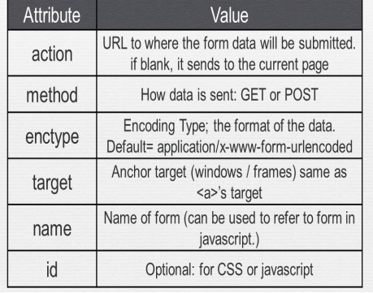
Forms
HTML Forms are required to collect different kinds of user inputs, such as contact details like name, email address, phone numbers, or details like credit card information, etc.
<input> - Input tag is used to take input from user
Image : Forms Attributes
https://slideplayer.com/slide/9288191/28/images/7/%3Cform%3E+attributes.jpg
Notes:
HTML Forms
HTML Forms are required to collect different kinds of user inputs, such as contact details like name, email address, phone numbers, or details like credit card information, etc.

Slide 42
Attribute of input tag
Different values of type attributes create different types of input
Type = text – Create textbox
Type = password – Create textbox but text is in not visible form
Type = number – Create a scroll up and down for number value
Type = radio – Create radio button
Type = checkbox – Create checkbox
Type = file – Create option for file uploading
Type = submit – Create submit button
Type = reset – Create reset button

Slide 43
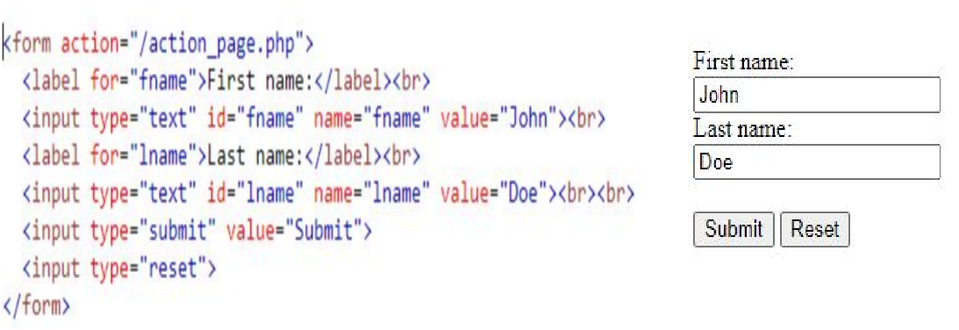
Forms - example
Image: HTML-Forms
https://www.w3schools.com/html/tryit.asp?filename=tryhtml_input_reset

Slide 44
HTML5 Audio and Video
Now we don't need any third-party plugin, like flash to play audio or video in our website.
HTML5 Audio tag is used to play audio files, like mp3, ogg, and AAC. All browsers supporting audio tags are having built-in player.
HTML5 Video tag or <video> is used to add videos on a webpage. Video tag supports mp4, ogg, mov and H.264 files.

Slide 45
Entities
HTML Entities are used to display reserved characters and special characters on a webpage. Html cannot show all characters. Some characters are reserved by html.
To write special characters in HTML, we use HTML Entities. We can write an HTML entity by Entity No or Entity name.
10,000+ html entities.

Slide 46


